Slide 1

C# µServices
BASTA Spring 2018
Rainer Stropek
software architects gmbh
Web
Mail
Twitter
http://www.timecockpit.com
rainer@timecockpit.com
@rstropek
Microservices with C#

Slide 2

Your Host
Rainer Stropek
Developer, Entrepreneur
MVP Microsoft Azure
MVP Development Technologies
MS Regional Director
Senior Consultant IT-Visions
Contact
software architects gmbh rainer@timecockpit.com Twitter: @rstropek

Slide 3
Introduction

Slide 4
.NET in einer Welt von Microservices
Neues Jahr, neue Vorsätze, neuer C# Workshop. Diesmal setzt Rainer Stropek beim BASTA!-Workshop-Klassiker den Schwerpunkt ganz auf die Entwicklung moderner Microservices-Lösungen mit C# und .NET. An Beispielen zeigt Rainer, wie man mit
.NET Core,
den Architekturprinzipien von Microservices
und der Azure-Cloud
in der Praxis moderne SaaS-Lösungen erstellt.
Natürlich kommen aktuelle Entwicklungen rund um die Sprache C#, .NET und Visual Studio nicht zu kurz. Im C# Workshop sieht man diese Dinge in ein praxisnahes Beispiel verpackt und kann sie so direkt mit in den eignen Arbeitsalltag nehmen.

Slide 5
Microservices
An Introduction

Slide 6
What are Microservices?
Small, autonomous services working together
Single responsibility principle applied to SOA
See also concept of Bounded Context
Best used with DevOps and continuous deployment
Enhance cohesion, decrease coupling, enable incremental evolvement
How small are Microservices?
It depends (e.g. team structure, DevOps maturity, etc.)
“… one agile team can build and run it”, “… can be rebuilt by a small team in two weeks”
Find an individual balance
Autonomous = deploy changes without affecting others
Technology- and platform-agnostic APIs
See also https://en.wikipedia.org/wiki/Microservices

Slide 7
Loose Coupling
Tight Coupling
A change in one module usually forces a ripple effect of changes in other modules
See also Disadvantages of Tight Coupling
Loose Coupling
Components have little or no knowledge of the definitions of other components
Coupling is reduced by e.g. standards, queues, etc.
Microservices = loose coupling wanted
Single change → single deployment
No timing issues (if system A is deployed, system B needs update at the same time)

Slide 8
Cohesion
Highly cohesive systems
Functionality is strongly related
Modules belong together
Microservices = high cohesion wanted
Functions grouped in a services because all contribute to a single well-defined task
Reduce risk that a requirement concerns many different system components

Slide 9
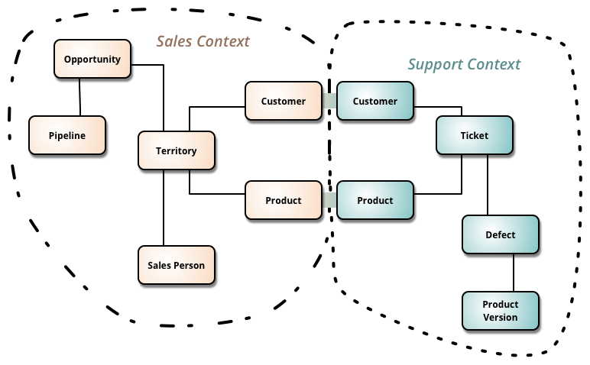
Bounded Context
Microservices often represent bounded contexts
Business-focused design
Less technical-focused design based on technical layers
Source: http://martinfowler.com/bliki/BoundedContext.html

Slide 10
Microservices
Microservices
Modeled around business concepts
Culture of Automation
Hide implementation details
Decentralized
Independently deployed
Isolate failures
Highly observable
Fundamental ideas
Work alongside many state-of-the-art approaches for software development
Agile development techniques
Continuous Integration/Delivery
DevOps
Cloud Computing
Containers

Slide 11
Why? Why not?

Slide 12
Why Microservices?
Work well in heterogeneous environments
Right tool for the job
Available skills of team members
Grown environment (e.g. M&A, changing policies, changing overall designs)
Easier to test/adopt new technologies
Reduce risk and cost of failure
New platforms (e.g. Node.js instead of .NET), new versions (e.g. .NET Core),
Resilience
Reduce single point of failures
Support different SLAs for difference modules (costs, agility)
Separation of services add complexity (e.g. network) → criticism of Micrservices

Slide 13
Why Microservices?
Let people take responsibility
Teams “own” their services
You build it, you run it
Scaling
Fine-grained scaling is possible
Simplify deployment of services
Overall, deployment of many Microservices might be more complex → criticism
Deployment patterns: https://www.nginx.com/blog/deploying-microservices/

Slide 14
Why Microservices?
Composability
Hexagonal architecture
Ability to replace system components
Outdated technology
Changed business requirements

Slide 15
Why Not? (Examples)
Harder to debug and troubleshoot
Distributed system
Possible mitigation: Mature logging and telemetry system
Performance penalty
Network calls are relatively slow
Possible mitigation: Remote calls for larger units of work instead of chatty protocols
No strong consistency
We are going to miss transactions!
Possible mitigation: Idempotent retries

Slide 16
Why Not? (Examples)
Harder to manage
You have to manage lots of services which are redeployed regularly
Possible mitigation: DevOps, Automation
System is too small
For small systems, monolithic approach is often more productive
Cannot manage a monolith (e.g. deployment)? You will have troubles with Microservices!
Environment with lots of restrictions
Microservices need a high level of autonomy

Slide 17
Team Organization

Slide 18
Conway‘s Law
„Any organization that designs a system will inevitably produce a design whose structure is a copy of the organization’s communication structure”
Organizational hurdles for Microservices
Tightly-coupled organizations
Geographically distributed teams
Missing tools (e.g. self-service cloud infrastructure, CI/CD tools)
Unstable or immature service that frequently changes
Missing culture of taking ownership (need someone to blame)
Cope with many different and new technologies
Source: Conway, How Do Committees Invent, Datamation magazine, April 1968

Slide 19
Organisational Helpers
Co-locate teams
One team responsible for a single service should be co-located
Embrace open source development style
Works internally, too
Internal consultants, custodians and trusted committers
Quality gateways
Servant leaders
Step-by-step approach
Be clear in communication
E.g. responsibilities, long-term goals, changing roles

Slide 20
Microservices Architects…
…don‘t create perfect end products
…help creating “a framework in which the right systems can emerge, and continue to grow”
…understand the consequences of their decisions
…code with the team (“architects should code”, “coding architect”)
…aims for a balance between standardization and freedom
Build skills for a certain technology vs. right tool for the right job
…create guiding principals and practices
Example for principals (largely technology-independent): https://12factor.net/
Example for practices (often technology-dependent): .NET Core Coding Guildelines
Recommended reading: Newman, Sam. Building Microservices, O'Reilly Media

Slide 21
Guidance, Governance
Samples
Small code samples vs. perfect examples from real world
Templates, code generators
Examples: Visual Studio Templates, .NET Core CLI, Angular CLI
Shared libraries
Be careful about tight coupling!
Example: Cross-platform libraries based on .NET Standard Library for cross-cutting concerns
Handle and track exceptions from principals and practices
Remember goal of Microservices: Optimize autonomy
→ Exceptions should be allowed

Slide 22
DevOps habits and practices
PRACTICES
Application Performance Management
Infrastructure as Code
Continuous Deployment
Release Management
Configuration Management
Automated Recovery
PRACTICES
Automated Testing
Continuous Integration
Continuous Deployment
Release Management
PRACTICES
Usage Monitoring
Telemetry Collection Testing in Production
Stakeholder Feedback
PRACTICES
Code Reviews
Automated Testing
Continuous Measurement
FLOW OF CUSTOMER VALUE
TEAM AUTONOMY & ENTERPRISE ALIGNMENT
BACKLOG refined with LEARNING
EVIDENCE gathered in PRODUCTION
MANAGED TECHNICAL DEBT
PRODUCTION FIRST MINDSET
INFRASTRUCTURE is a FLEXIBLE RESOURCE
PRACTICES
Testing in Production
Usage Monitoring
User Telemetry
Stakeholder feedback
Feature flags
PRACTICES
Application Performance Management
Infrastructure as Code
Continuous Delivery
Release Management
Configuration Management
Automated Recovery
PRACTICES
Enterprise Agile
Continuous Integration
Continuous Deployment
Release Management

Slide 23
Technical Aspects

Slide 24
Microservice Interfaces

Slide 25
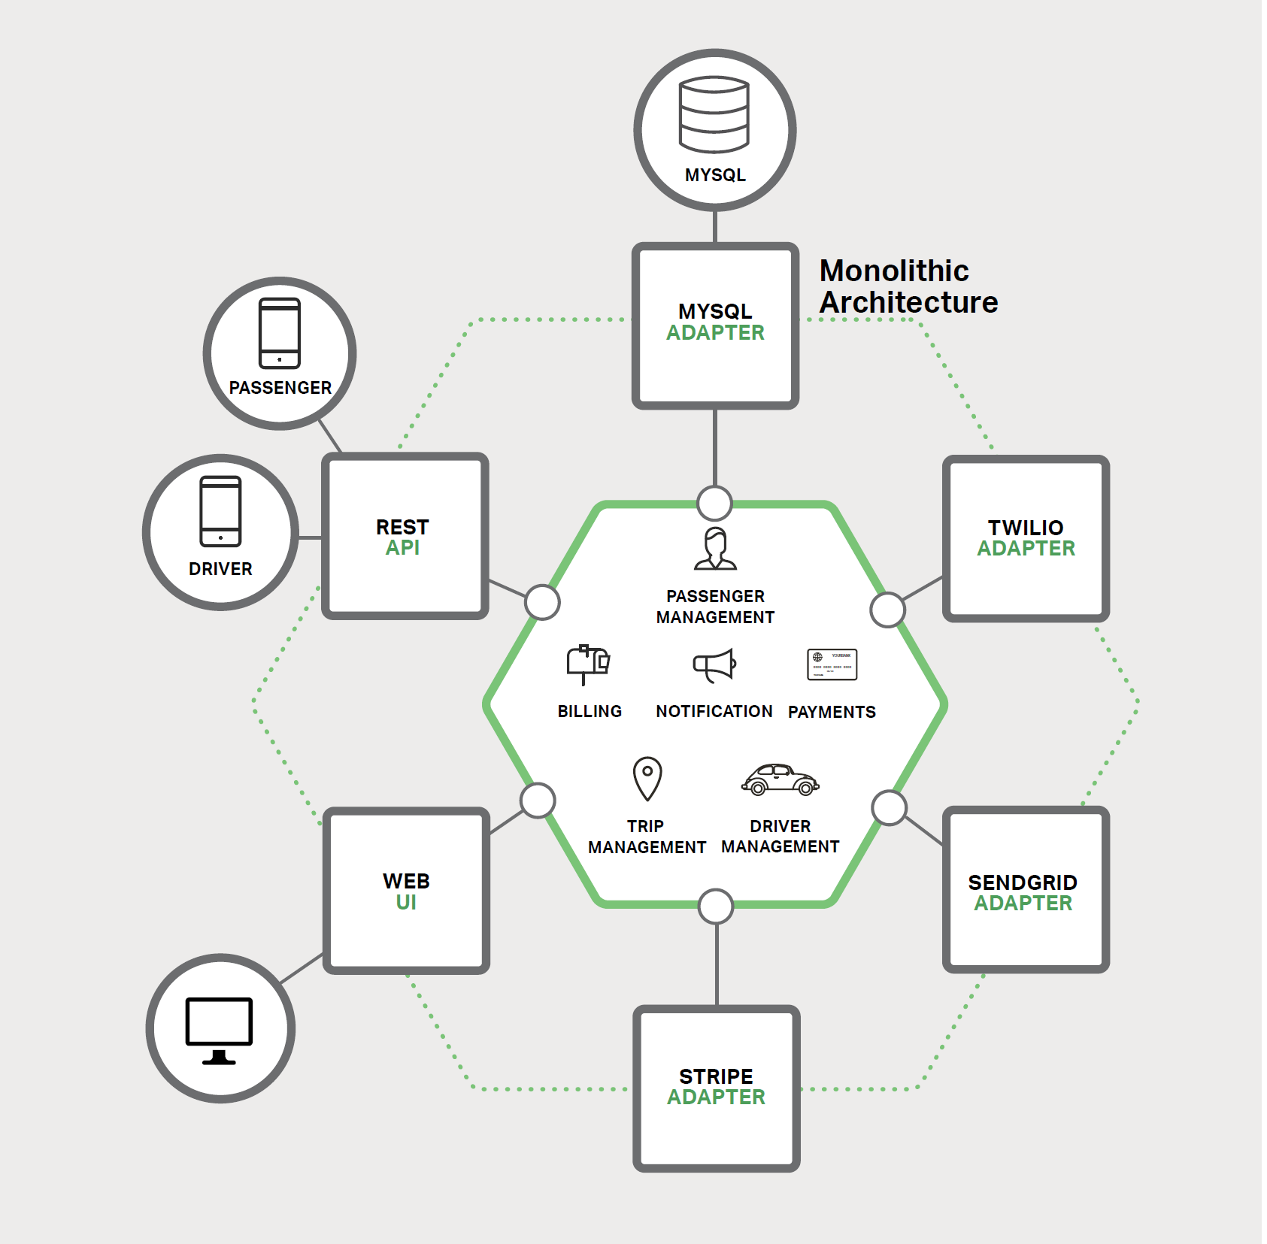
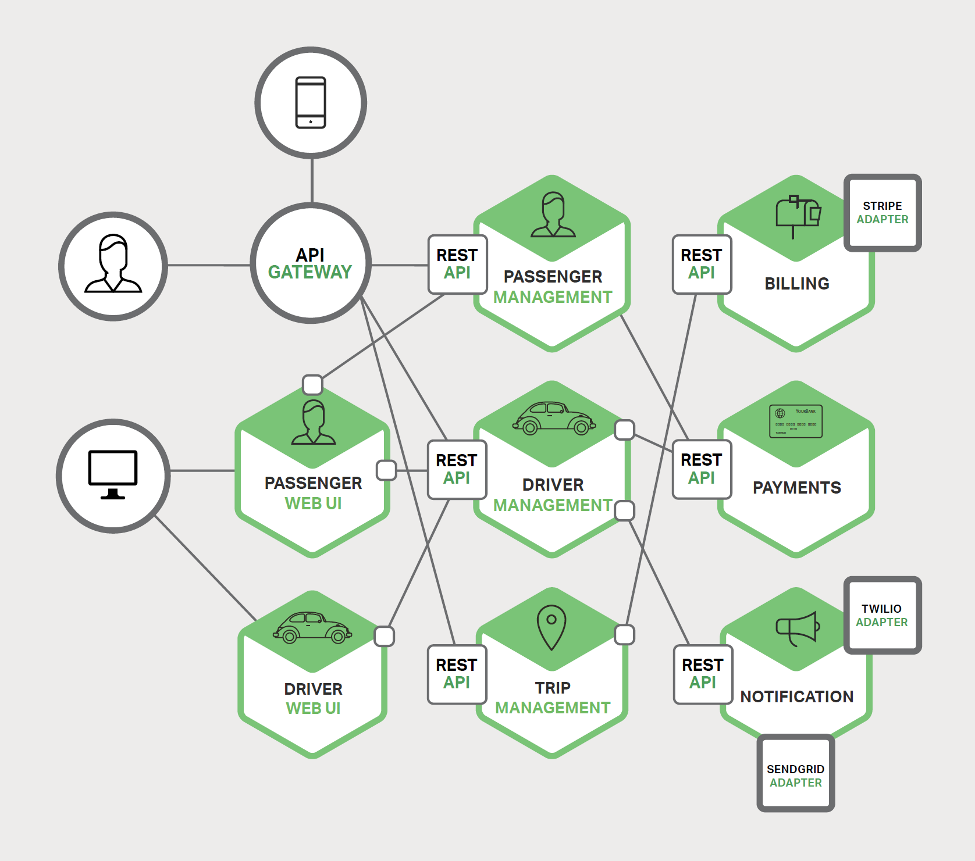
From Monolith to Microservices
Image Source: Chris Richardson, Microservices – From Design to Deployment, NGINX, 2016

Slide 26
Interfaces
Small number of communication standards
Examples: HTTP/REST, OData, GraphQL, OpenID Connect
Goals: Interoperability, productivity (economy of scope), detect malfunctions
Practices and principles for typical use-cases needed
Status Codes
Data encoding
Paging
Dynamic filtering
Sorting
Long-running operations
…
See also https://speakerdeck.com/rstropek/restful-web-api-design

Slide 27
Interface Technology
Tolerant against changes
See also Breaking Change in Microsoft’s REST API Guidelines
Technology-agnostic
Simple to use and provide
Availability of tools, libraries, frameworks, knowledge
Hide implementation details
Shared Database anti-pattern

Slide 28
Interface Design
Synchronous communication
Request/response pattern
Bidirectional communication
Example: RESTful Web API, WebSockets
Asynchronous communication
Event-driven
Examples: Service Bus, RabbitMQ, Apache Kafka, Webhooks
Central orchestration or autonomy?
Example: Business Process Modelling and Execution
Further reading: https://www.nginx.com/blog/event-driven-data-management-microservices/

Slide 29
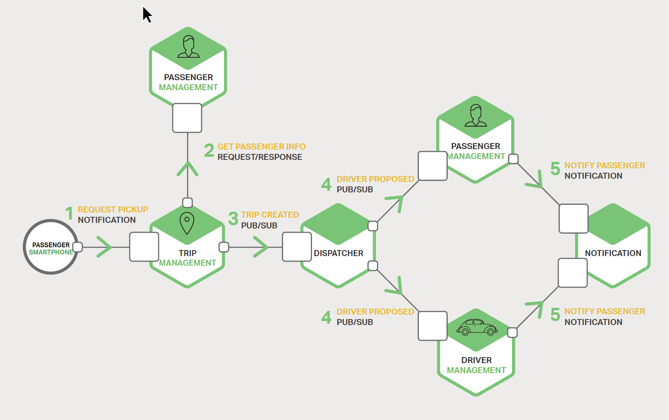
Interface Mechanisms
Image Source: Chris Richardson, Microservices – From Design to Deployment, NGINX, 2016

Slide 30
Handling Failures
Partial failures
Single service must not kill entire system
Outage vs. degradation
Performance degradation
Single dependent service not available
Circuit breaker pattern
Track success of requests
Stop trying if error rate/performance exceeds threshold
Regular health check or retry

Slide 31
Versioning
Semantic Versioning (SemVer)
Raise awareness for breaking changes
Definition of a breaking change is necessary
Avoid breaking changes
Discussion point: JSON vs. XAML deserializer in C#
Offer multiple versions in parallel
Give consumers time to move
Use telemetry to identify slow movers

Slide 32
Libraries vs. Microservices
Goal: Don‘t Repeat Yourself (DRY)
Contraction to Microservices architecture?
Good for…
…cross-cutting concerns (use existing, wide-spread libraries)
…sharing code inside a service boundary
Client libraries
Hide complexity of communication protocol
Implement best practices (e.g. retry policy)
Example: Azure Active Directory Authentication Libraries
UI components
Service provides UI fragments (e.g. WebComponents)

Slide 33
Automation
Continuous Integration and Deployment, Tests

Slide 34
CI/CD
One code repository and CI/CD build per service
Possible: Common infrastructure for economy of scope and scale
Build and deployment pipeline
Compile and fast tests (unit tests)
Slow tests
UAT (manual tests, explorative tests)
Performance testing (e.g. cloud load testing)
Separate deployment from release
E.g. Azure App Service stages with swapping
Canary releasing
Direct portion of your traffic against new release and monitor stability

Slide 35
Monitoring
System-wide view of our system‘s health
Contains data from all services
Logging
Telemetry (e.g. CPU and memory usage, response times, dependent requests, etc.)
Microsoft‘s solutions
Visual Studio Application Insights
3rd party solutions
Log analysis with Elastic Stack
Dynatrace (leader in Gartner Magic Quadrant)

Slide 36
Manual Testing
Manual testing: try the program and see if it works!
Tester plays the role of a user
Checks to see if there is any unexpected or undesirable behavior
Test plans with specified test cases
Drawbacks
Slow
Requires lots of resources → expensive
Cannot be performed frequently
Heavy manual testing is a showstopper for Microservices

Slide 37
Testing Level
Unit Test
Test single function or class
Service Tests
Bypass UI and test service directly
Stubs or mockups for dependent services/resources (e.g. Mountbank)
End-to-End Tests
Hard in a Microservice environment (e.g. which versions to test?)
Tend to be flaky and brittle
Good approach: Test a few customer-driven “journeys”

Slide 38
Deployment

Slide 39
Deployment Strategies
Single service instance per host
Inefficient
Multiple service instances per host
Efficient in terms of resource usage
No isolation → no resource limitation, no isolated environments, no sandboxes
Service instance per VM
Based on a common image
Complete isolation
Uses resources less efficient → expensive
Requires mature virtualization environment

Slide 40
Deployment Strategies
Service instance per container
Based on a common image (automatically created)
High level of isolation (like VMs if you use e.g. Windows Hyper-V Container)
Requires running container environment (e.g. Docker Cloud, Azure Container Services)
Serverless deployments
E.g. Azure App Service, Azure Functions
Reduce operations to a minimum

Slide 41
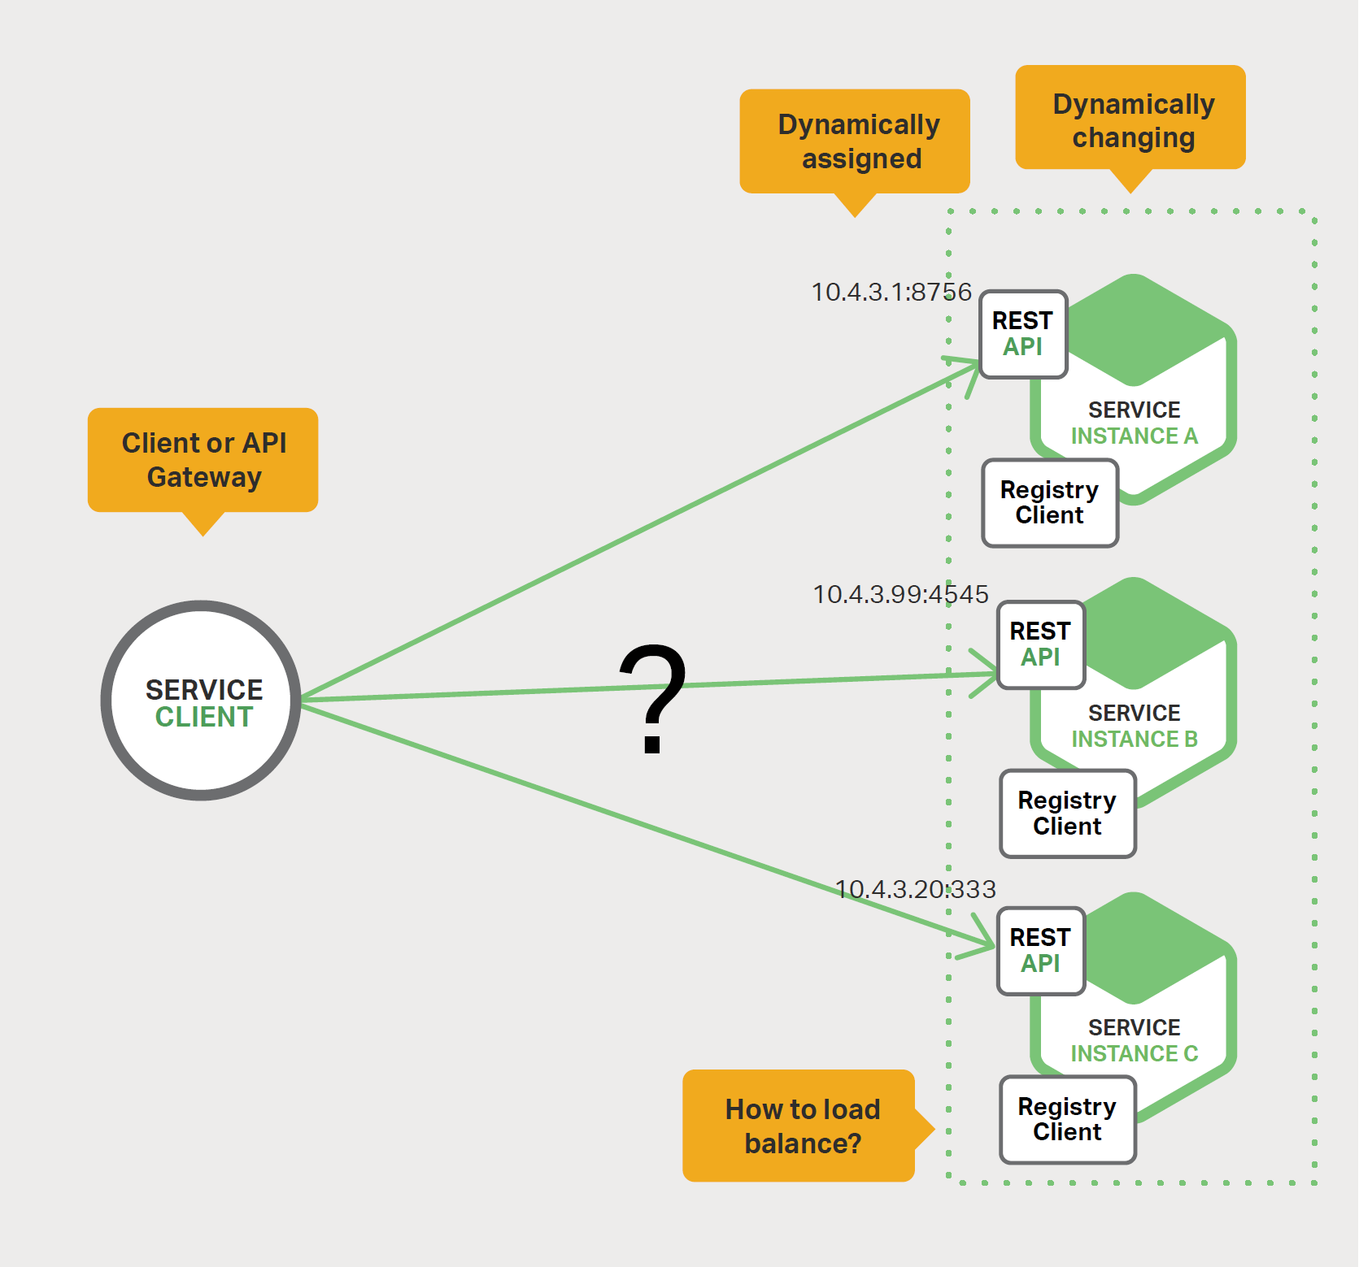
Service Discovery
Dynamically assigned addresses
Changing environment
Failures
Scaling
New versions
Tools
DNS (e.g. Azure DNS)
Load Balancer (e.g. Azure LB)
Discovery and config tools (e.g. Consul)
Image Source: Chris Richardson, Microservices – From Design to Deployment, NGINX, 2016

Slide 42
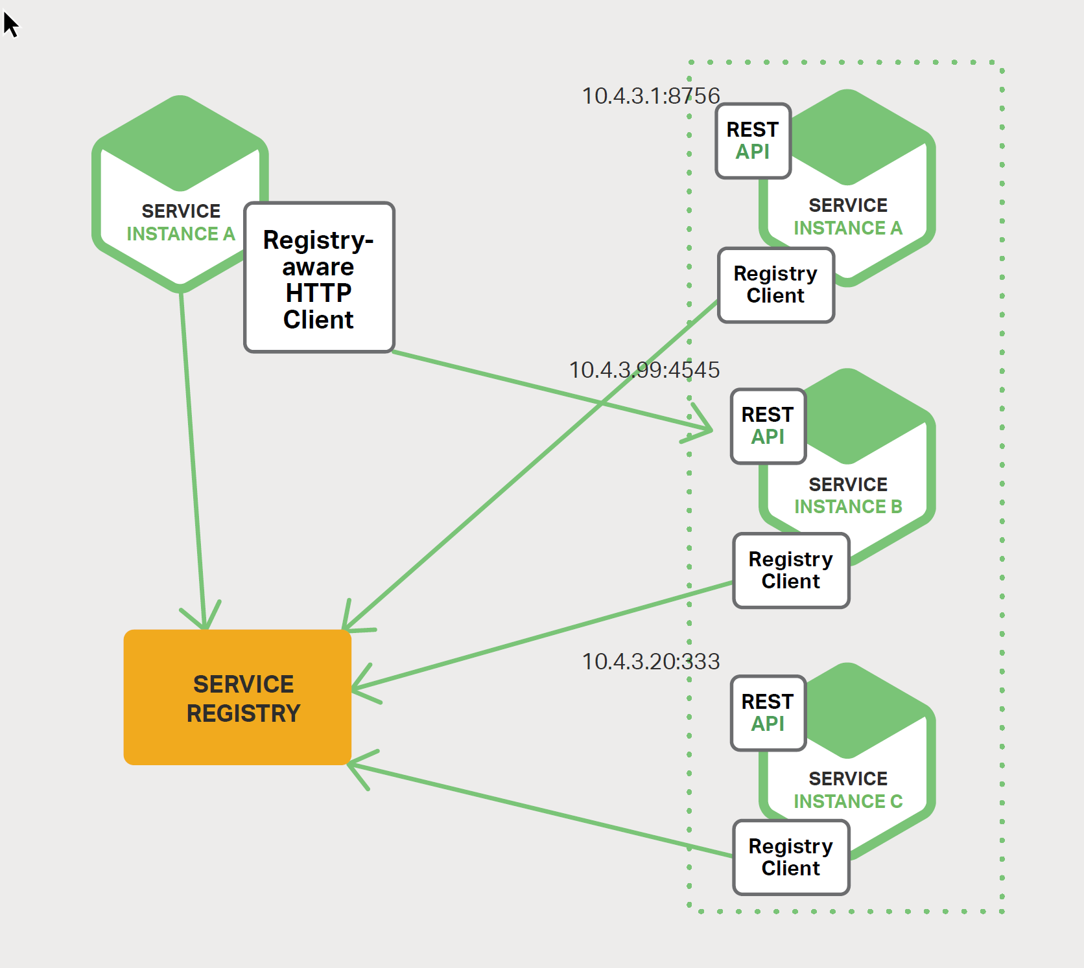
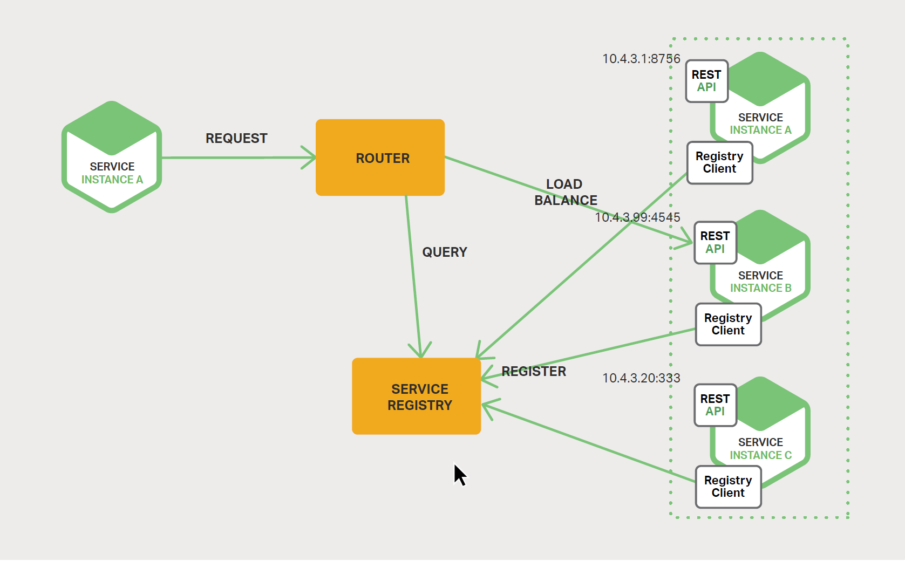
Client vs. server-side discovery
Image Source: Chris Richardson, Microservices – From Design to Deployment, NGINX, 2016

Slide 43
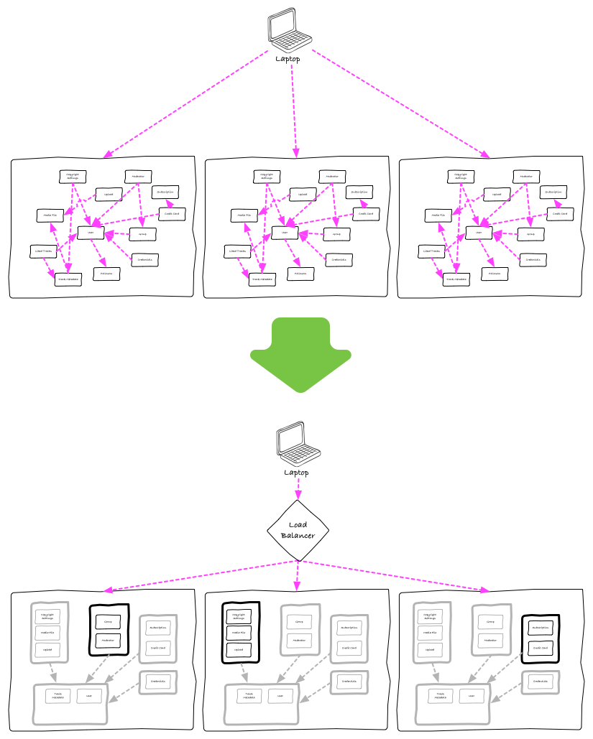
Deployment
Architecture
Old: Each node contains entire system
New: Unrelated modules behind load balancer/reverse proxy
API Gateways
Marshal backend calls
Aggregate content
Example: Azure API Management
Source: How we ended up with microservices

Slide 44
Data Management

Slide 45
Data Management
Each Microservice has its own data
No transactions
No distributed queries
Duplicated data to a certain extent
Event-driven architecture
Requires service bus or message broker (e.g. Service Bus, RabbitMQ, Apache Kafka)
Option: Use DB transaction log
Event sourcing and CQRS
Read more in MSDN, Martin Fowler

Slide 46
Transactions
Question and avoid ACID transactions across services
Perfectly fine inside service boundaries
Has consequences on API design (e.g. Azure Storage Entity Group Transactions)
Idempotent retry
Gather data, try again later
Use compensating transactions

Slide 47
Further Readings

Slide 48
Further Readings
Martin Fowler on Microservices
Newman, Sam. Building Microservices, O'Reilly Media
NGINX
Tech Blog
Microservices: From Design to Deployment

Slide 49
.NET Core

Slide 50
Why .NET Core?
Refactor .NET Framework
Establish a Standard Library for the various incarnations of .NET .NET Core is not 100% compatible with .NET 4.x (details)
Make it a real cross-platform solution
Windows, Mac OS, Linux (details in .NET Core Roadmap)
Make it open source
A .NET Foundation project
MIT License
Details: https://docs.microsoft.com/dotnet/

Slide 51
Components of .NET Core
.NET Runtime (CoreCLR)
CoreCLR includes Base Class Library (BCL)
.NET Core Foundation Libraries (CoreFX)
.NET Command Line Tools (.NET CLI)
Including the dotnet application host
Cross-Platform Compiler (Roslyn)

Slide 52
Status of .NET Core
.NET Core 2.0 is RTM (Aug. 2017)
Download current version
2.1 is scheduled for 2018 (roadmap)
Visual Studio Tools are RTM
Visual Studio 2017
C# is RTM
X64 Support
X86, X64 support on Windows
X64 support on many Linux distros
Community-supported version for Raspberry Pi
See also: https://github.com/dotnet/core/blob/master/roadmap.md

Slide 53
What can you build?
Console applications
ASP.NET Core applications
UWP applications
Xamarin Forms applications
See also: https://github.com/dotnet/core/blob/master/roadmap.md

Slide 54
Where to get .NET Core?
.NET Core landing page
With Visual Studio tools (Visual Studio prerequisites)
Command-line tools (with your own editor, e.g. VSCode, download)
.NET Install Script (details, download)
You have to care for the prerequisites
NuGet
Packages and Metapackages
Docker: microsoft/dotnet image (details)
.NET Core Source Browser
See also: https://github.com/dotnet/core/blob/master/roadmap.md

Slide 55
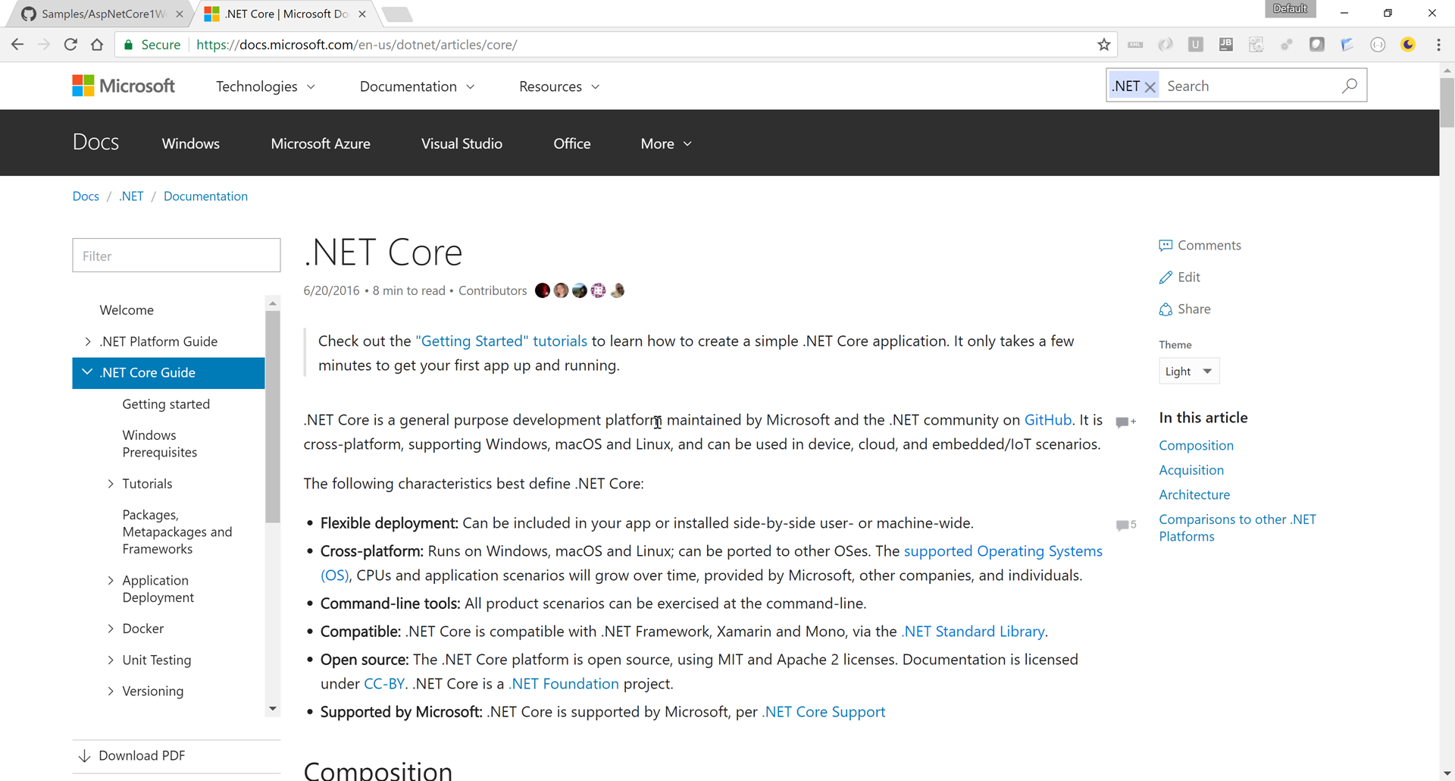
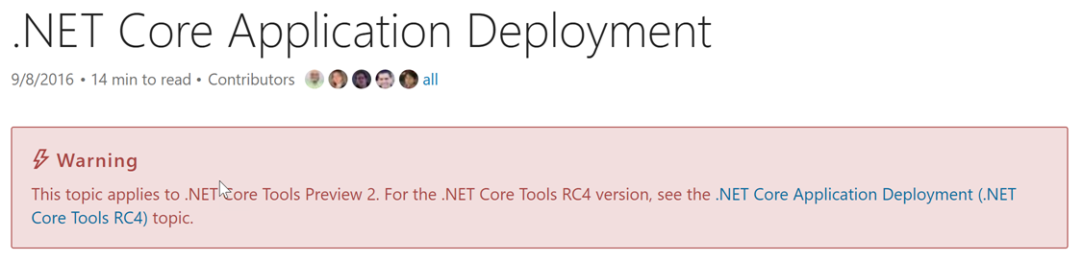
Getting Help
New https://docs.microsoft.com

Slide 56
Packages, Metapackages and Frameworks
Create console app with CLI
Analyze .csproj
Discuss .csproj reference
Run app
Publish app
Further readings
More about cross-platform libraries
MSBuild Project File Schema Reference
Creating new templates
Runtime Configuration Files
https://github.com/rstropek/Samples/tree/master/AspNetCore1Workshop/10-console-hello-world

Slide 57
.csproj
<Project Sdk="Microsoft.NET.Sdk">
<PropertyGroup>
<OutputType>Exe</OutputType>
<TargetFramework>netcoreapp2.0</TargetFramework>
</PropertyGroup>
</Project>
<Project Sdk="Microsoft.NET.Sdk">
<PropertyGroup>
<TargetFramework>netstandard2.0</TargetFramework>
</PropertyGroup>
</Project>
For executable, not present for class libraries
Target Framework
Class library based on .NET Standard 2.0
See also MSBuild Project File Schema Reference

Slide 58
Solutions
Create solution: dotnet new sln
Add proj.: dotnet sln add …
Create solution in VS2017
.NET Standard class library with Json.NET
.NET Framework console app with reference
Further readings
.NET Core Tools MSBuild
https://github.com/rstropek/Samples/tree/master/AspNetCore1Workshop/25-project-references

Slide 59
Cross-platform
Run app on Linux using Docker
microsoft/dotnet images
Multi-step build
Docker support in VS2017
See also https://github.com/dotnet/dotnet-docker-samples

Slide 60
.NET CLI

Slide 61
.NET Core CLI
dotnet command
new – create project
migrate –project.json → .csproj
restore – restore dependencies
run – run source code without explicit compile
build – builds project and dependencies
test – runs unit tests
pack – packs code into a NuGet package
publish – packs the app and dependencies for publishing
https://docs.microsoft.com/en-us/dotnet/core/tools/index?tabs=netcore2x

Slide 62
dotnet run
Run application from the source code
Use dotnet without any command to run a built DLL
Uses dotnet build in the background
Important parameters
--framework
--configuration <Debug|Release>
https://docs.microsoft.com/en-us/dotnet/articles/core/preview3/tools/dotnet-run

Slide 63
Deployment (dotnet publish)
Framework-dependent deployment
Shared system-wide version of .NET Core must be present on target system
DLLs are launched using dotnet
DLLs are portable
Self-contained deployment
No prerequisites on target system necessary
Does not contain native prerequisites
Results in an platform-specific executable
Optional: Use CrossGen for native image generation
https://docs.microsoft.com/en-us/dotnet/core/deploying/

Slide 64
Self-contained Deployment
Create self-contained sample
See following slides
Build and publish SCD
dotnet publish -c release
dotnet publish -c release -r win-x64
dotnet publish -c release -r linux-x64
Runtime Identifier (RID) (details)
Release instead of debug version (need not ship PDBs)
https://github.com/rstropek/Samples/tree/master/AspNetCore1Workshop/27-self-contained

Slide 65
Versioning

Slide 66
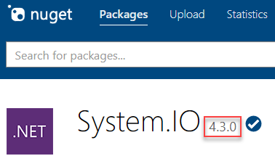
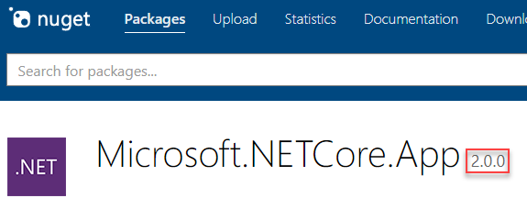
Versioning
Framework version changes when APIs are added
No implementation → no patch numbers
Example: netcoreapp2.0
Package versions
System.* packages use 4.x numbers (overlap with .NET Framework)
Packages without overlapping with .NET Framework → 1.x/2.x
https://docs.microsoft.com/en-us/dotnet/articles/core/versions/index

Slide 67
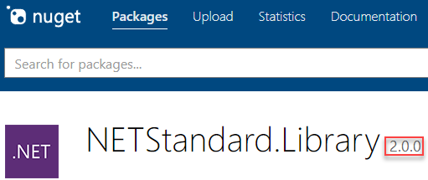
Versioning
.NET Standard Library
Versioning independent of any .NET runtime, applicable to multiple runtimes
2.0 for .NET Core 2.0
Examples
https://docs.microsoft.com/en-us/dotnet/articles/core/versions/index

Slide 68
Libraries

Slide 69
Libraries
Shared files
Libraries
Creating NuGet packages
dotnet pack
Further readings
More about cross-platform libraries
Tools for porting code from .NET Framework

Slide 70
.NET Standard Library

Slide 71
.NET today—reusing code
.NET FRAMEWORK
.NET CORE
XAMARIN
APP
MODELS
WPF
Windows Forms
UWP
iOS
Android
ASP.NET
ASP.NET Core
OS X
BASE
LIBRARIES
.NET Framework BCL
.NET Core BCL
Mono BCL
Notes:
Notes: Even if we are reusing a lot across components (especially with the open sourcing last year), the reality is that each platform has its own implementation of the base libraries.
Note: .NET Framework BCL and Mono BCL are the same APIs, different implementation. .NET Core “Core Library” is a similar set of APIs, but different.

Slide 72
.NET today—reusing code
.NET FRAMEWORK
.NET CORE
XAMARIN
CHALLENGES
Difficult to reuse skills
Need to master 3+1 base class libraries
Difficult to reuse code
Need to target a fairly small common denominator
Difficult to innovate
Need implementations on each platform
APP
MODELS
WPF
Windows Forms
UWP
iOS
Android
ASP.NET
ASP.NET Core
OS X
BASE
LIBRARIES
.NET Framework BCL
.NET Core BCL
Mono BCL
Notes:
Notes: Even if we are reusing a lot across components (especially with the open sourcing last year), the reality is that each platform has its own implementation of the base libraries.
Note: .NET Framework BCL and Mono BCL are the same APIs, different implementation. .NET Core “Core Library” is a similar set of APIs, but different.

Slide 73
.NET tomorrow
.NET FRAMEWORK
.NET CORE
XAMARIN
APP
MODELS
WPF
Windows Forms
UWP
iOS
Android
ASP.NET
ASP.NET Core
OS X
BASE
LIBRARIES
.NET Standard
Notes:
Notes: Even if we are reusing a lot across components (especially with the open sourcing last year), the reality is that each platform has its own implementation of the base libraries.
Note: .NET Framework BCL and Mono BCL are the same APIs, different implementation. .NET Core “Core Library” is a similar set of APIs, but different.

Slide 74
.NET tomorrow
.NET FRAMEWORK
.NET CORE
XAMARIN
BENEFITS
Reuse skills
Master one BCL, not a Venn diagram
Reuse code
Common denominator is much bigger
Faster innovation
Target .NET Standard & run anywhere
APP
MODELS
WPF
Windows Forms
UWP
iOS
Android
ASP.NET
ASP.NET Core
OS X
BASE
LIBRARIES
.NET Standard
Notes:
Notes: Even if we are reusing a lot across components (especially with the open sourcing last year), the reality is that each platform has its own implementation of the base libraries.
Note: .NET Framework BCL and Mono BCL are the same APIs, different implementation. .NET Core “Core Library” is a similar set of APIs, but different.

Slide 75
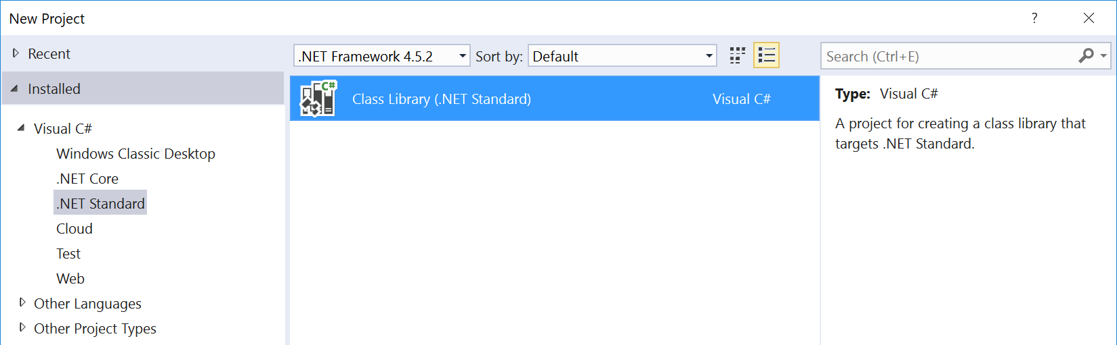
What is .NET Standard?
.NET Standard is a specification
A set of APIs that all .NET platforms have to implement
.NET Standard
.NET Framework
.NET Core
Xamarin
~
~
HTML specification
Browsers

Slide 76
.NET Standard 2.0
Has much bigger API surface
Extended to cover intersection between .NET Framework and Xamarin
Makes .NET Core 2.0 bigger as it implements .NET Standard 2.0
+20K
More APIs than
.NET Standard 1.x
Can reference .NET Framework libraries
Compat shim allows referencing existing .NET Framework code – without recompilation
Limited to libs that use APIs that are available for .NET Standard
~70%
of NuGet packages
are API compatible

Slide 77
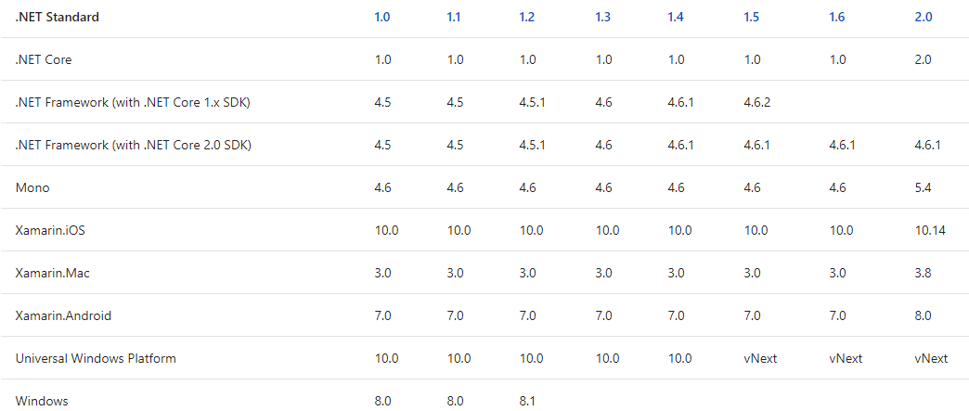
Why a standard library?
CLR (CLI) has already been standardized (ECMA 334)
No standardized BCL prior to .NET Core
Goal: Standard BCL API for all .NET platforms
Easier to create portable libraries
Reduce conditional compilation
What about PCLs?
Well defined API instead of just intersection of platforms
Better versioning
Overlapping PCL profiles (details)
Details: https://docs.microsoft.com/en-us/dotnet/articles/standard/library

Slide 78
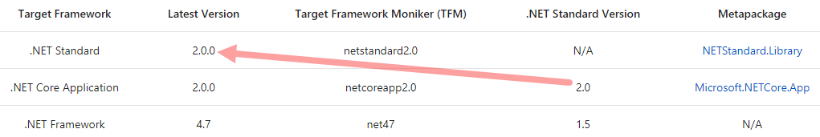
.NET Standard Library
Standard APIs defined as empty C# classes
Example: ref folder in System.Runtime
NETStandard.Library (NuGet)
Metapackage for .NET Standard Library
Details: https://docs.microsoft.com/en-us/dotnet/articles/standard/frameworks

Slide 79
Migration
.NET Portability Analyzer
https://github.com/Microsoft/dotnet-apiport
Reference .NET Framework assemblies
They just work, without recompile

Slide 80
.NET Portability Analyzer
NQuery

Slide 81
ASP.NET Core Basics
Practical use of .NET Core

Slide 82
Minimal ASP.NET Core
ASP.NET Pipeline
Discuss “a la carte” framework
Add static files (sample)
Kestrel
Windows, Linux with Docker
Visual Studio Code
Further readings
Building middlewares
https://github.com/rstropek/Samples/tree/master/AspNetCoreWorkshop/50-simplest-aspnet

Slide 83
Walkthrough VS “File – New – Project”
Create web project in VS2015
Walkthrough
Servers (IIS and Kestrel)
Environments
Adding MVC

Slide 84
101 for ASP.NET Core
Application Startup
Main Method
Startup class with ConfigureServices (DI) and Configure (Pipeline)
Static Files
Environments
Servers
IIS, Kestrel

Slide 85
Configuration
No web.config anymore
Key/value pair settings from different providers
E.g. memory, environment variables, JSON, INI, XML
Extensible
Details about writing custom providers
Options pattern for DI integration

Slide 86
Configuration
In-memory configuration
JSON configuration
Configuration via command line
Configuration with environment variables
Options pattern
See practical use in AppInsights
https://github.com/rstropek/Samples/tree/master/AspNetCoreWorkshop/55-configuration/

Slide 87
Logging
Support for logging built into ASP.NET Core
Various logger built in
E.g. console, NLog
Details about logging
Consider using Application Insights
Getting started with AppInsights in ASP.NET Core

Slide 88
Logging
JSON file to configure logging
.NET Core Logging
AppInsights
Custom logging
AppInsights portal
https://github.com/rstropek/Samples/tree/master/AspNetCoreWorkshop/58-logging/

Slide 89
Dependency Injection
Support for DI built into ASP.NET Core
Details about DI
Framework-provided services and your own services
Service Lifetime
Transient, Scoped, Singleton, Instance
Default container can be replaced (details)

Slide 90
Dependency Injection
Setting up DI
Service Lifetime
https://github.com/rstropek/Samples/tree/master/AspNetCoreWorkshop/60-di-scopes/

Slide 91
.NET Core Automation
Test, build, and release automation

Slide 92
CI with .NET Core apps
VSTS supports building and publishing .NET Core apps
Details
Azure App Services supports .NET Core apps
Kudu-support for .NET Core
Ready-made Docker image with Dockerfile
microsoft/dotnet

Slide 93
Build Automation
Build and deploy .NET Core in VSTS
https://www.visualstudio.com/en-us/docs/build/apps/aspnet/aspnetcore-to-azure

Slide 94
Dockerfile for .NET Core app

Slide 95
Unit Testing
.NET Core supports multiple test frameworks
E.g. XUnit, MSTest
Compare XUnit and MSTest

Slide 96
Unit Testing
Create and run library with tests
XUnit (sample)
MSTest (sample)
Run tests with
dotnet xunit
dotnet test
See also https://xunit.github.io/docs/getting-started-dotnet-core

Slide 97
C# 7
Live Coding; sample code see https://github.com/rstropek/Samples/tree/master/CSharp7

Slide 98
Azure Resource Manager
Why do we need ARM?

Slide 99
In the Early Days…
Azure Service Management API was the version 1 that provided programmatic access for functionality in the Azure platform
Very limited functionality
Examples: ASM can be used to configure Cloud Services, Storage accounts, Virtual Networks
No way to target multi-region or multi-service in a single script
No consistency in the API exposed by services
XML, some used JSON
Limited access control
Subscription co-administrator for providing user access
Limited auditing available from the portal
Hard to organize lots of resources across the organization

Slide 100
Consistent Management Layer
Azure Resource Manager API

Slide 101
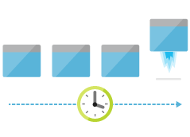
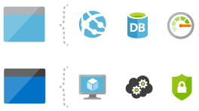

Areas of Focus
Deploy
Organize
Control

Slide 102
Deploying with ARM
template-driven
declarative
idempotent
multi-service
multi-region
extensible

Slide 103
Support for IaaS and PaaS
Support for IaaS
Incl. Networking
Support for PaaS
Mixed environments
E.g. web app in IaaS, SQL DB in PaaS

Slide 104
Resources
Resource Manager Overview
https://azure.microsoft.com/en-us/documentation/articles/resource-group-overview/
Supported Services
https://azure.microsoft.com/en-us/documentation/articles/resource-manager-supported-services/
Template Language Reference
https://azure.microsoft.com/en-us/documentation/articles/resource-group-authoring-templates/

Slide 105
Advanced Concepts, Resources
Template functions
E.g. string functions, numeric functions, array functions, deployment values, etc.
https://azure.microsoft.com/en-us/documentation/articles/resource-group-template-functions/
Template linking
https://azure.microsoft.com/en-us/documentation/articles/resource-group-linked-templates/
Creating multiple instances
https://azure.microsoft.com/en-us/documentation/articles/resource-group-create-multiple/
Best Practices
https://azure.microsoft.com/en-us/documentation/articles/best-practices-resource-manager-design-templates/

Slide 106
Summary
Infrastructure is code
ARM makes Azure ready for large-scale
Number of resources, regions, etc.
ARM makes management easier
E.g. idempotency, tags, access control
ARM is cross-platform
PowerShell, Azure CLI, or REST
Create Linux and Windows resources

Slide 107
Serverless
An Introduction

Slide 108
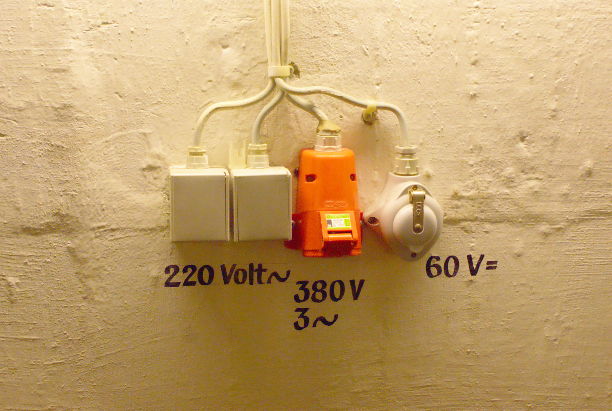
Image Source: https://flic.kr/p/73eSV7

Slide 109
Microservices
Source: http://martinfowler.com/bliki/BoundedContext.html

Slide 110

Autonomous Teams
Image Source: https://flic.kr/p/4JGGFW

Slide 111
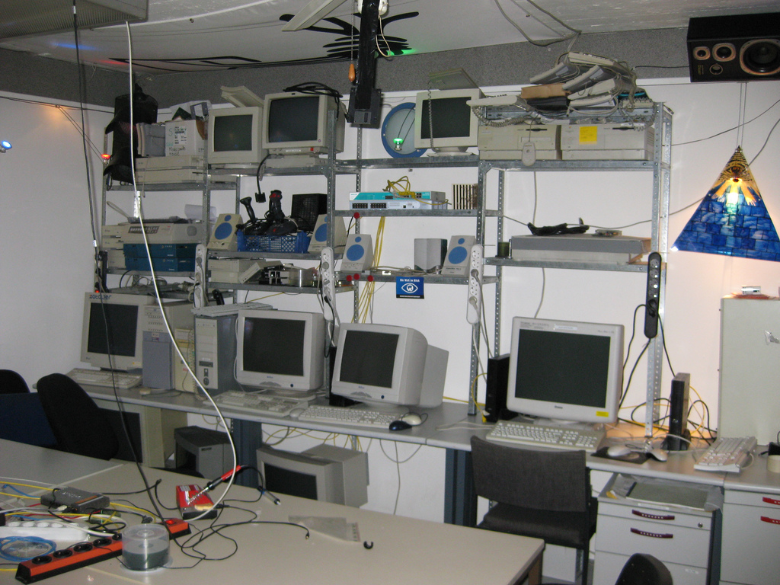
Image Source: https://flic.kr/p/5VB88j

Slide 112

Image Source: https://flic.kr/p/65RcDT

Slide 113

Image Source: https://flic.kr/p/5qtj4r

Slide 114
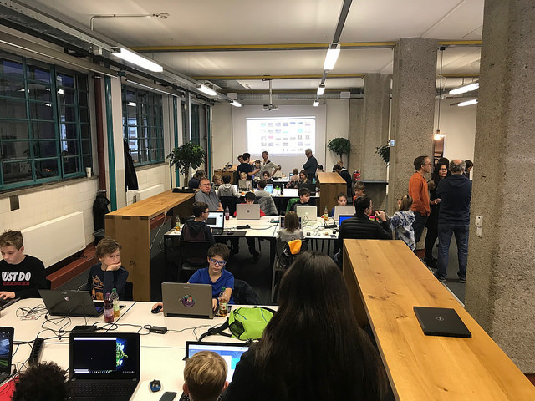


Slide 115
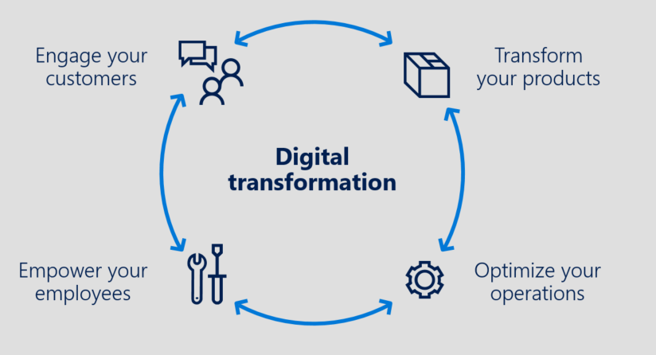
From IaaS to … Innovation with PaaS
Advanced Analytics & Big Data, IoT, App Innovation / Intelligent Apps / Serverless …
PaaS
DIFFERENTIATION
VALUE TO BUSINESS
Storage, Back-up & DR
INNOVATION
APPLICATIONS AND SERVICES
Compute & Networking
EFFICIENCY
IaaS
TIME

Slide 116
Why Not?

Slide 117

Trust is Required
Image Source: https://flic.kr/p/9nWs1

Slide 118

Specific Needs
Image Source: https://flic.kr/p/gWCWqU

Slide 119
Azure Functions

Slide 120
Getting Started
Functions ≈ WebJobs on steroids
Scripting, Web UI
Functions are implemented using Azure App Services
Good to be familiar with App Services when working with Functions

Slide 121
Azure Functions Characteristics
Choice of language
C#, F#, TypeScript, etc.
Pay-per-use pricing model
Dynamic App Service Plan
Support for NuGet and NPM
Integrated security
Support for OAuth providers like AAD, Facebook, Google, Twitter, and Microsoft Account
Code-less integration
Flexible development
In-portal editor or set up continuous integration (e.g. GitHub, VSTS, local Git repository)

Slide 122
Triggers & Bindings
Timer
HTTP (Web Host)
REST, Webhook
Azure Storage
Blobs, Queues, Tables
Service Bus
Queues, Topics
DocumentDB
Details

Slide 123
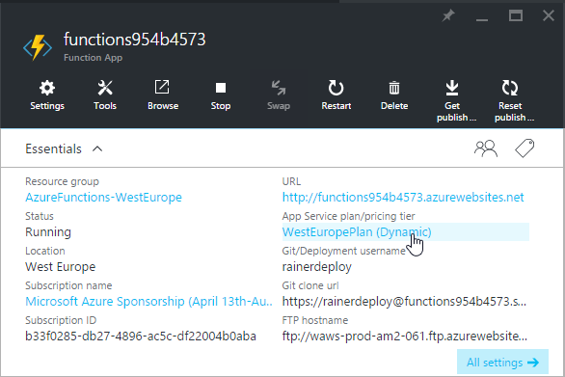
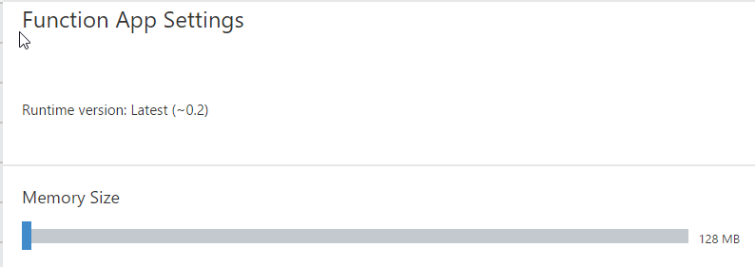
Dynamic App Service Plan
Only pay for the time that your code spends running
Functions pricing (based on “GB-s”, “Gigabyte Seconds”)
„nearest 100ms at Per/GB price based on the time your function runs and the memory size of the function space you choose”

Slide 124
C# Function
using System.Net;
public static async Task<HttpResponseMessage> Run(HttpRequestMessage req, TraceWriter log) {
log.Info("Received Tic-Tac-Toe request");
var board = await req.Content.ReadAsAsync<string[]>();
if (board.Length != 9) {
return req.CreateResponse(HttpStatusCode.BadRequest, "No valid tic-tac-toe board");
}
for(var row = 0; row < 3; row ++) {
if (!string.IsNullOrWhiteSpace(board[row * 3])
&& board[row * 3] == board[row * 3 + 1] && board[row * 3] == board[row * 3 + 2]) {
return BuildResponse(req, board[row * 3]);
}
}
for(var column = 0; column < 3; column ++) {
if (!string.IsNullOrWhiteSpace(board[column])
&& board[column] == board[3 + column] && board[column] == board[2 * 3 + column]) {
return BuildResponse(req, board[column]);
}
}
if (!string.IsNullOrWhiteSpace(board[0])
&& board[0] == board[3 + 1] && board[0] == board[2 * 3 + 2]) {
return BuildResponse(req, board[0]);
}
if (!string.IsNullOrWhiteSpace(board[2])
&& board[2] == board[3 + 1] && board[2] == board[2 * 3]) {
return BuildResponse(req, board[1]);
}
return BuildResponse(req);
}
private static HttpResponseMessage BuildResponse(HttpRequestMessage req, string winner = null)
=> req.CreateResponse(HttpStatusCode.OK, new { winner = winner });
TicTacToe Logic
Create Function App
Consumption Plan
Application Insights integration
Create in Portal
Call via HTTP (Insomnia)
Show background files
C# Scripts
JSON configuration files

Slide 125
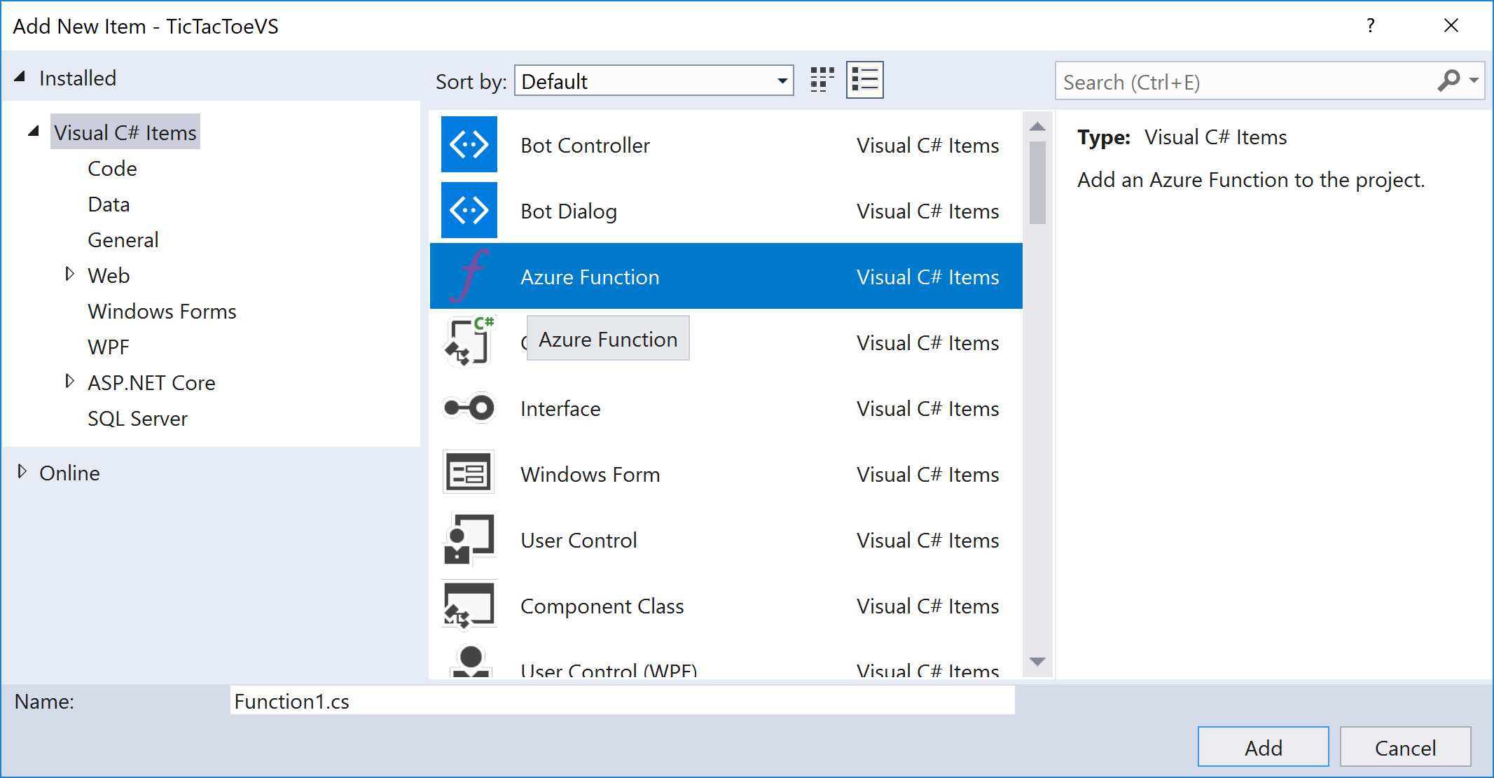
C# Function
Develop in Visual Studio
Create Function App
Visual Studio
Debugging with VS
Deploy using VS

Slide 126
Node.js Function
func init --no-source-control
func templates list
func new
-> Answer wizard questions (Node.js)
func start
Local Development
Create Function App
Node.js
Call via HTTP (Insomnia)

Slide 127
Node Function
module.exports = function (context, req) {
// Parse request body
var board = JSON.parse(req.body);
// Make sure that body is a properly formed array
if (Array.isArray(board) && board.length == 9) {
// Body is ok -> send message to trigger analysis
context.bindings.outputSbMsg = { Message: board };
// Send OK result to caller
context.res = { status: 202 };
context.done();
}
else {
// Body is malformed -> send Bad Request to caller
context.res = { status: 400, body: "No valid tic-tac-toe board" };
context.done();
}
};
TicTacToe Validator
Create Queue Binding
Call via HTTP (Insomnia)

Slide 128
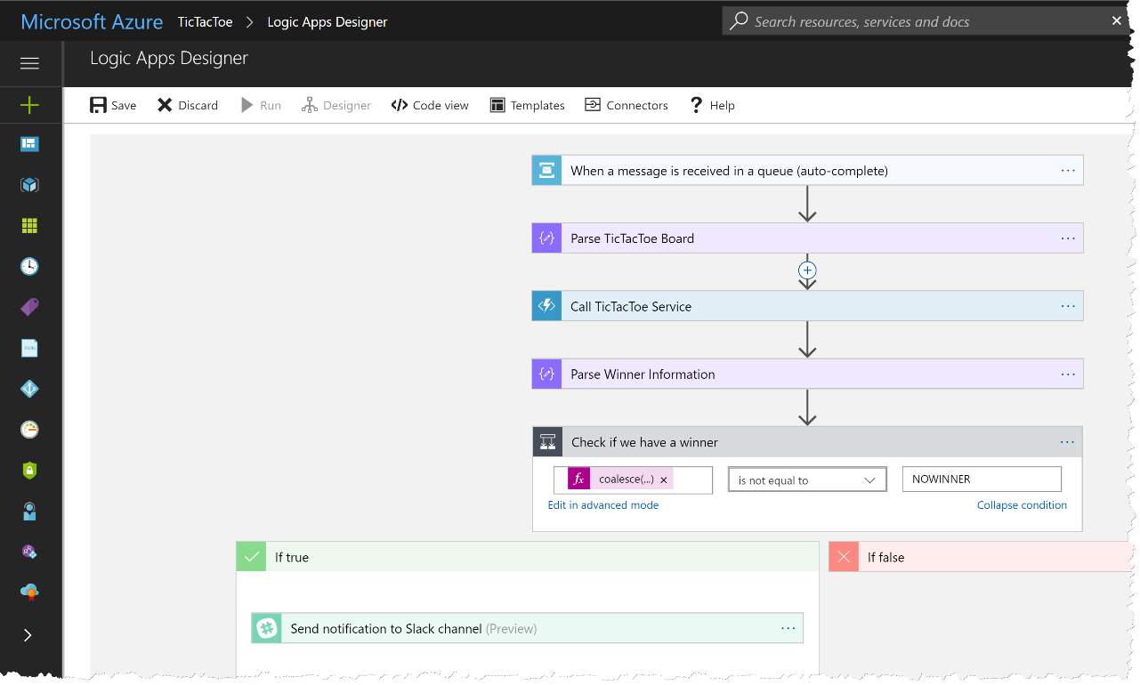
Logic App
Combine Functions with Workflows
Create function
Connect with Service Bus
Views
Design View
Code View

Slide 129
Logic App
"triggers": {
"When_a_message_is_received_in_a_queue_(auto-complete)": {
"inputs": {
"host": {
"connection": {
"name": "@parameters('$connections')['servicebus']['connectionId‘]“
}
},
"method": "get",
"path": "/@{encodeURIComponent(encodeURIComponent('tictactoe-request'))}/messages/head",
"queries": {
"queueType": "Main"
}
},
"recurrence": {
"frequency": "Second",
"interval": 15
},
"type": "ApiConnection"
}
}
TicTacToe Validator

Slide 130
Logic App
"Parse_TicTacToe_Board":{
"inputs":{
"content":"@base64toString(triggerBody()?['ContentData'])",
"schema":{
"properties":{
"Message":{
"items":{
"type":"string"
},
"type":"array"
}
},
"type":"object"
}
},
"runAfter":{
},
"type":"ParseJson"
}
TicTacToe Validator

Slide 131
Logic App
"Call_TicTacToe_Service":{
"inputs":{
"body":"@body('Parse_TicTacToe_Board')?['Message']",
"function":{
"id":"/subscriptions/26400a43-e689-48df-95dc-0b173a362cff/resourceGroups/serverless-hagenberg/providers/Microsoft.Web/sites/serverless-demo-func/functions/TicTacToe"
},
"headers":{
"x-functions-key":"zV6jby5icU3PaAx0...JgbOYef12Cqh3qD3zrvC/Q=="
},
"method":"POST"
},
"runAfter":{
"Parse_TicTacToe_Board":[
"Succeeded"
]
},
"type":"Function"
}
TicTacToe Validator

Slide 132
Logic App
"Parse_Winner_Information":{
"inputs":{
"content":"@body('Call_TicTacToe_Service')",
"schema":{
"properties":{
"winner":{
"type":"string"
}
},
"type":"object"
}
},
"runAfter":{
"Call_TicTacToe_Service":[
"Succeeded"
]
},
"type":"ParseJson"
}
TicTacToe Validator

Slide 133
Logic App
"Check_if_we_have_a_winner":{
"actions":{
"Send_notification_to_Slack_channel":{
"inputs":{
"host":{
"connection":{
"name":"@parameters('$connections')['slack']['connectionId']"
}
},
"method":"post",
"path":"/chat.postMessage",
"queries":{
"channel":"C02FJAB8J",
"text":"@{body('Parse_Winner_Information')?['winner']} is the winner"
}
},
"runAfter":{
},
"type":"ApiConnection"
}
},
"expression":"@not(equals(coalesce(body('Parse_Winner_Information')?['winner'], 'NOWINNER'), 'NOWINNER'))",
"runAfter":{
"Parse_Winner_Information":[
"Succeeded"
]
},
"type":"If"
}
TicTacToe Validator

Slide 134
What Else?

Slide 135
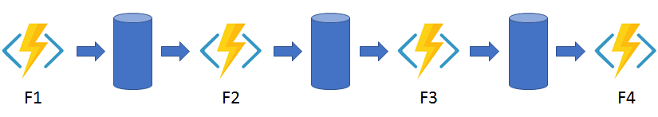
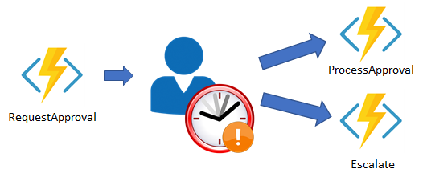
Durable Functions (Preview)
Function Chaining
Human Interaction
https://docs.microsoft.com/en-us/azure/azure-functions/durable-functions-overview

Slide 136
Summary

Slide 137
Summary
It‘s all about Microservices
Specialized services working together to form a customer solution
Resources on demand
How much does your software cost if it is in standby?
Idempotency
There are no transactions → when in doubt, send again
Prepare for failures
Out-of-sync issues, unreliable networks, servers constantly change, etc.
Importance of logging and telemetry
Learn and implement OpenID Connect
AAD is an easy-to-use option

Slide 138
Image Source: https://flic.kr/p/73eSV7

Slide 139
.NET and Docker
An Introduction

Slide 140
Everybody knows Docker?
Do we need a whirlwind recap?

Slide 141
Docker Images
.NET Core
https://hub.docker.com/r/microsoft/dotnet/
ASP.NET Core
https://hub.docker.com/r/microsoft/aspnetcore/
https://hub.docker.com/r/microsoft/aspnetcore-build/
.NET 3.5 and 4.x
https://hub.docker.com/r/microsoft/dotnet-framework/
ASP.NET 3.x and 4.x
https://hub.docker.com/r/microsoft/aspnet/
CI/CD
https://hub.docker.com/r/microsoft/vsts-agent/

Slide 142
Read more…
Samples from this talk
https://github.com/rstropek/DockerVS2015Intro/tree/master/dockerDemos/08-docker-dot-net
ASP.NET and Docker
https://docs.microsoft.com/en-us/aspnet/mvc/overview/deployment/docker-aspnetmvc
Dockerize .NET Core
https://docs.docker.com/engine/examples/dotnetcore/

Slide 143
Q&A
Time cockpit eLearning Library
Rainer Stropek
software architects gmbh
Mail Web Twitter
rainer@timecockpit.com http://www.timecockpit.com @rstropek
Thank your for coming!

